Slide 1
Process-to-process Delivery
The data link layer is responsible for delivery of frames between two neighboring nodes over a link. This is called node-to-node delivery.
The network layer is responsible for delivery of datagrams between two hosts. This is called host-to-host delivery.
Real communication takes place between two processes (application programs).
In process-to-process delivery, at any moment, several processes may be running on the source host and several on the destination host.
To complete the delivery, A mechanism is required to deliver data from one of these processes running on the source host to the corresponding process running on the destination host.
The transport layer is responsible for process-to-process delivery—the delivery of a packet, part of a message, from one process to another.
Two processes communicate in a client/server relationship.

Slide 2
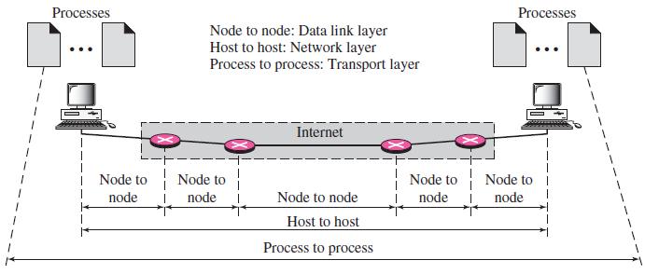
Process-to-process Delivery

Slide 3
Process-to-process Delivery: Client/Server Paradigm
A remote computer can run several server programs at the same time, just as local computers can run one or more client programs at the same time.
For communication, we must define the following:
1. Local host
2. Local process
3. Remote host
4. Remote process

Slide 4
Process-to-process Delivery: Addressing
At the transport layer, transport layer address is required, called a port number, to choose among multiple processes running on the destination host.
The destination port number is needed for delivery; the source port number is needed for the reply.
In the Internet model, the port numbers are 16-bit integers between 0 and 65,535.
The client program defines itself with a port number, chosen randomly by the transport layer software running on the client host. This is the ephemeral port number.

Slide 5
Process-to-process Delivery: Addressing
The server process must also define itself with a port number.
If the computer at the server site runs a server process and assigns a random number as the port number, the process at the client site that wants to access that server and use its services will not know the port number.
Of course, one solution would be to send a special packet and request the port number of a specific server, but this requires more overhead.
The Internet has decided to use universal port numbers for servers; these are called well-known port numbers.

Slide 6
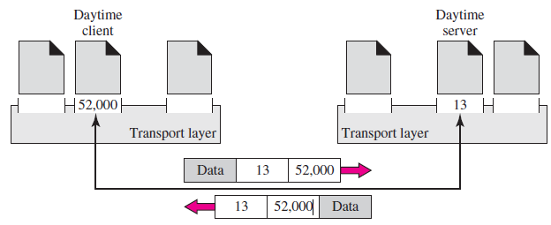
Process-to-process Delivery: Addressing

Slide 7
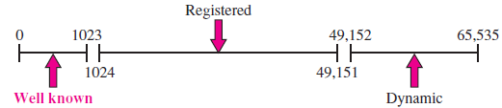
Process-to-process Delivery: IANA Ranges
The IANA (Internet Assigned Number Authority) has divided the port numbers into three ranges: well known, registered, and dynamic (or private):
Well-known ports. The ports ranging from 0 to 1023 are assigned and controlled by IANA. These are the well-known ports.
Registered ports. The ports ranging from 1024 to 49,151 are not assigned or controlled by IANA. They can only be registered with IANA to prevent duplication.
Dynamic ports. The ports ranging from 49,152 to 65,535 are neither controlled nor registered. They can be used by any process. These are the ephemeral ports.

Slide 8
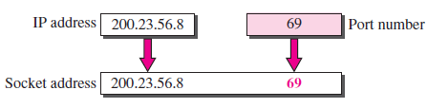
Process-to-process Delivery: Socket Addresses
Process-to-process delivery needs two identifiers, IP address and the port number, at each end to make a connection. The combination of an IP address and a port number is called a socket address.
A transport layer protocol needs a pair of socket addresses: the client socket address and the server socket address.
These four pieces of information are part of the IP header and the transport layer protocol header.
The IP header contains the IP addresses; the UDP or TCP header contains the port numbers.

Slide 9
Process-to-process Delivery: Connectionless Versus Connection-Oriented Service
In a connectionless service, the packets are sent from one party to another with no need for connection establishment or connection release. The packets are not numbered; they may be delayed or lost or may arrive out of sequence. There is no acknowledgment either. E.g. UDP.
In a connection-oriented service, a connection is first established between the sender and the receiver. Data are transferred. At the end, the connection is released. E.g. TCP & SCTP.

Slide 10
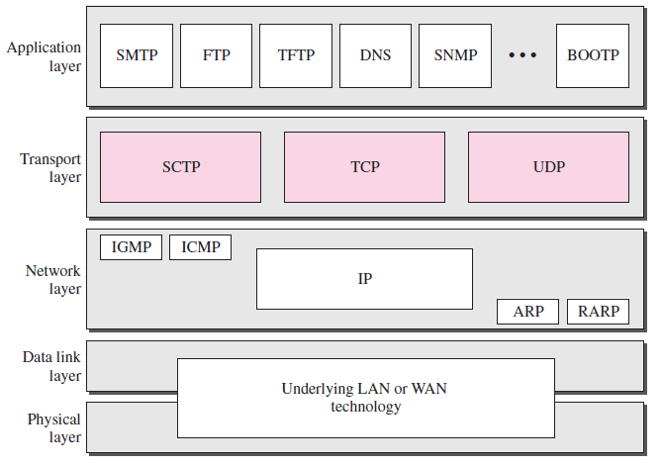
TCP/ IP Protocol Suite

Slide 11
USER DATAGRAM PROTOCOL (UDP)
The User Datagram Protocol (UDP) is called a connectionless, unreliable transport protocol.
It does not add anything to the services of IP except to provide process-to process communication instead of host-to-host communication.
Also, it performs very limited error checking.
UDP is a very simple protocol using a minimum of overhead.
If a process wants to send a small message and does not care much about reliability, it can use UDP.
Sending a small message by using UDP takes much less interaction between the sender and receiver than using TCP or SCTP.

Slide 12
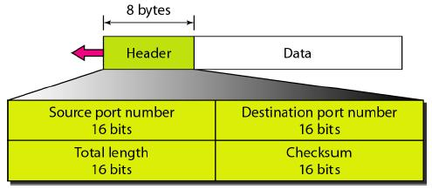
User datagram format

Slide 13
User datagram format
UDP packets, called user datagrams, have a fixed-size header of 8 bytes. The fields are as follows:
Source port number: This is the port number used by the process running on the source host. It is 16 bits long, which means that the port number can range from 0 to 65,535. If the source host is the client (a client sending a request), the port number, in most cases, is an ephemeral port number requested by the process and chosen by the UDP software running on the source host. If the source host is the server (a server sending a response), the port number, in most cases, is a well-known port number

Slide 14
User datagram format
Destination port number: This is the port number used by the process running on the destination host. It is also 16 bits long. If the destination host is the server (a client sending a request), the port number, in most cases, is a well-known port number. If the destination host is the client (a server sending a response), the port number, in most cases, is an ephemeral port number. In this case, the server copies the ephemeral port number it has received in the request packet

Slide 15
User datagram format
Length: This is a 16-bit field that defines the total length of the user datagram, header plus data. The 16 bits can define a total length of 0 to 65,535 bytes. However, the total length needs to be much less because a UDP user datagram is stored in an IP datagram with a total length of 65,535 bytes. There is a field in the IP datagram that defines the total length. There is another field in the IP datagram that defines the length of the header. So if we subtract the value of the second field from the first, we can deduce the length of a UDP datagram that is encapsulated in an IP datagram.
UDP length = IP length - IP header's length

Slide 16
User datagram format
Checksum: This field is used to detect errors over the entire user datagram (header plus data).

Slide 17
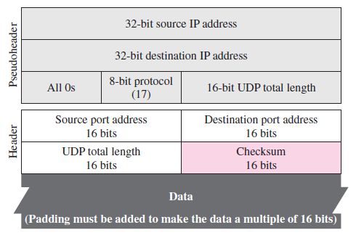

Slide 18
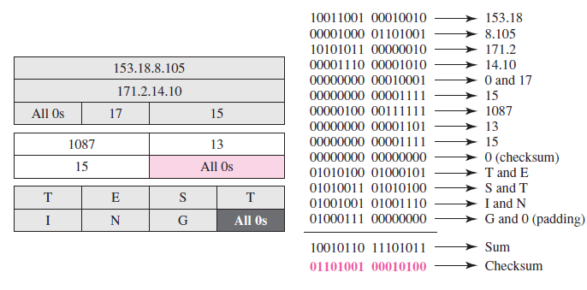

Slide 19
Use of UDP
UDP is suitable for a process that requires simple request-response communication with little concern for flow and error control. It is not usually used for a process such as FTP that needs to send bulk data.
UDP is suitable for a process with internal flow and error control mechanisms. For example, the Trivial File Transfer Protocol (TFTP) process includes flow and error control. It can easily use UDP.
UDP is a suitable transport protocol for multicasting. Multicasting capability is embedded in the UDP software but not in the TCP software.
UDP is used for management processes such as SNMP.
UDP is used for some route updating protocols such as Routing Information Protocol (RIP).

Slide 20
Transmission Control Protocol (TCP)
TCP is a connection oriented protocol; it creates a virtual connection between two TCPs to send data.
It adds connection-oriented and reliability features to the services of IP.
In addition, TCP uses flow and error control mechanisms at the transport level.
TCP, on the other hand, allows the sending process to deliver data as a stream of bytes and allows the receiving process to obtain data as a stream of bytes.
TCP creates an environment in which the two processes seem to be connected by an imaginary “tube” that carries their data across the Internet.
The sending process produces (writes to) the stream of bytes, and the receiving process consumes (reads from) them.

Slide 21
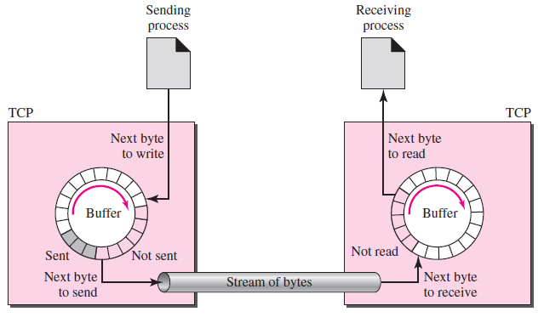
Transmission Control Protocol (TCP)

Slide 22
Transmission Control Protocol (TCP) Features
Numbering System: Although the TCP software keeps track of the segments being transmitted or received, there is no field for a segment number value in the segment header. Instead, there are two fields called the sequence number and the acknowledgment number. These two fields refer to the byte number and not the segment number.
Byte Number TCP numbers all data bytes that are transmitted in a connection. The numbering does not necessarily start from 0. Instead, TCP generates a random number between 0 and 2³² − 1 for the number of the first byte. For example, if the random number happens to be 1057 and the total data to be sent are 6000 bytes, the bytes are numbered from 1057 to 7056. Byte numbering is used for flow and error control.
Sequence Number After the bytes have been numbered, TCP assigns a sequence number to each segment that is being sent. The sequence number for each segment is the number of the first byte carried in that segment.

Slide 23
Transmission Control Protocol (TCP) Features
Acknowledgment Number: The acknowledgment number defines the number of the next byte that the party expects to receive. In addition, the acknowledgment number is cumulative, which means that the party takes the number of the last byte that it has received, safe and sound, adds 1 to it, and announces this sum as the acknowledgment number.
Flow Control
Error Control
Congestion Control
Segment

Slide 24
TCP Frame Format

Slide 25
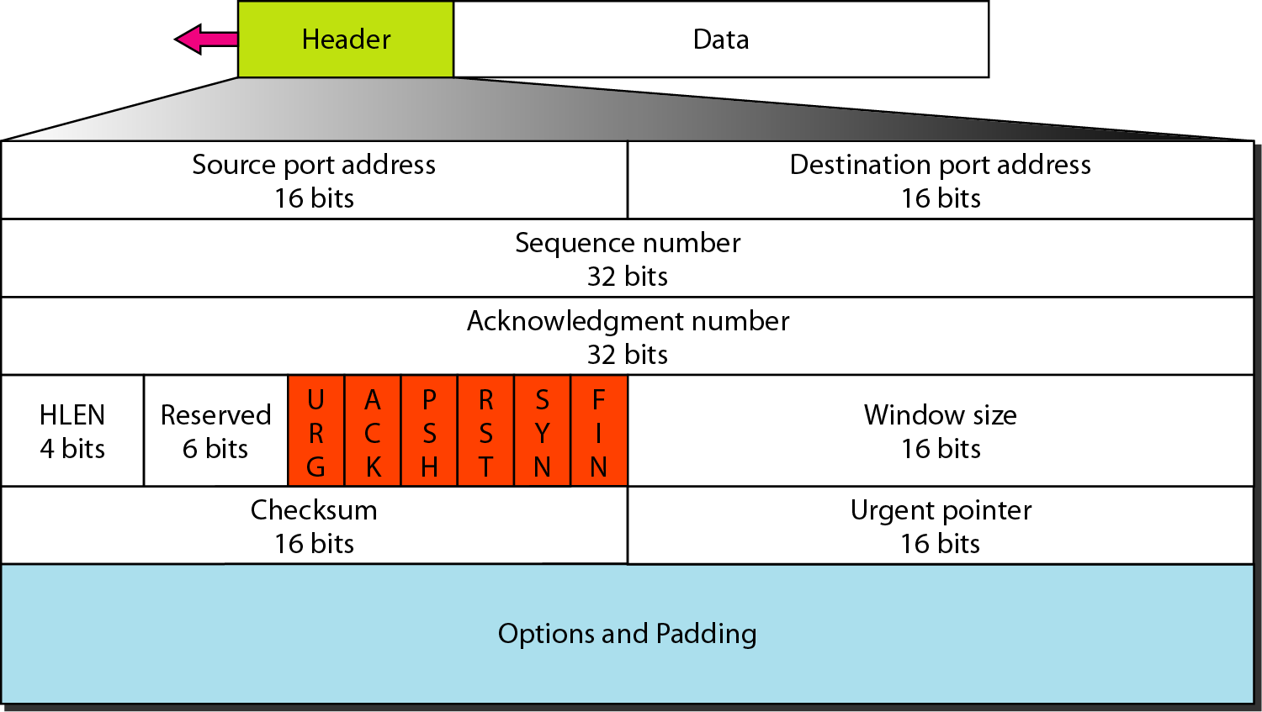
TCP segment format
The segment consists of a 20- to 60-byte header, followed by data from the application program. The header is 20 bytes if there are no options and up to 60 bytes if it contains options

Slide 26
TCP segment format
Source port address: This is a 16-bit field that defines the port number of the application program in the host that is sending the segment
Destination port address: This is a 16-bit field that defines the port number of the application program in the host that is receiving the segment

Slide 27
TCP segment format
Sequence number: This 32-bit field defines the number assigned to the first byte of data contained in this segment.
TCP is a stream transport protocol. To ensure connectivity, each byte to be transmitted is numbered.
The sequence number tells the destination which byte in this sequence comprises the first byte in the segment. During connection establishment, each party uses a random number generator to create an initial sequence number (ISN), which is usually different in each direction

Slide 28
TCP segment format
Acknowledgment Number: This This 32-bit field defines the byte number that the receiver of the segment is expecting to receive from the other party.
If the receiver of the segment has successfully received byte number x from the other party, it defines x + 1 as the acknowledgment number. Acknowledgment and data can be piggybacked together
Header length: This 4-bit field indicates the number of 4-byte words in the TCP header. The length of the header can be between 20 and 60 bytes.

Slide 29
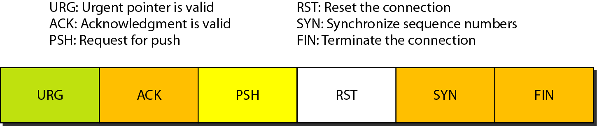
TCP segment format
Reserved: This is a 6-bit field reserved for future use
Control: This field defines 6 different control bits or flags

Slide 30
TCP segment format
Window size: This field defines the size of the window, in bytes, that the other party must maintain. Note that the length of this field is 16 bits, which means that the maximum size of the window is 65,535 bytes. This value is normally referred to as the receiving window (rwnd) and is determined by the receiver. The sender must obey the dictation of the receiver in this case

Slide 31
TCP segment format
Checksum: This 16-bit field contains the checksum. The calculation of the checksum for TCP follows the same procedure as the one described for UDP. However, the inclusion of the checksum in the UDP datagram is optional, whereas the inclusion of the checksum for TCP is mandatory. The same pseudoheader, serving the same purpose, is added to the segment. For the TCP pseudoheader, the value for the protocol field is 6

Slide 32
TCP segment format
Urgent pointer: This l6-bit field, which is valid only if the urgent flag is set, is used when the segment contains urgent data. It defines the number that must be added to the sequence number to obtain the number of the last urgent byte in the data section of the segment.
Options: There can be up to 40 bytes of optional information in the TCP header.

Slide 33
TCP Connection
1. The two TCPs establish a connection between them.
2. Data are exchanged in both directions.
3. The connection is terminated.

Slide 34
TCP Connection Establishment
Three-Way Handshaking
The three steps in this phase are as follows.
The client sends the first segment, a SYN segment, in which only the SYN flag is set. This segment is for synchronization of sequence numbers. It consumes one sequence number. When the data transfer starts, the sequence number is incremented by 1. We can say that the SYN segment carries no real data, but we can think of it as containing 1 imaginary byte.
The server sends the second segment, a SYN + ACK segment, with 2 flag bits set: SYN and ACK. This segment has a dual purpose. It is a SYN segment for communication in the other direction and serves as the acknowledgment for the SYN segment. It consumes one sequence number.

Slide 35
TCP Connection Establishment
Three-Way Handshaking
3. The client sends the third segment. This is just an ACK segment. It acknowledges the receipt of the second segment with the ACK flag and acknowledgment number field. Note that the sequence number in this segment is the same as the one in the SYN segment; the ACK segment does not consume any sequence numbers.

Slide 36
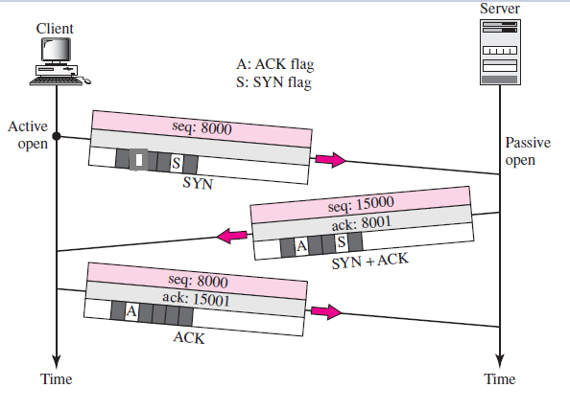

Slide 37
TCP Connection Establishment
At the time of connection establishment SYN flooding attack can take place which is a kind of denial-of-service attack.
The attacker sends a high volume of SYN packets to the targeted server, often with spoofed IP addresses.
The server then responds to each one of the connection requests and leaves an open port ready to receive the response.
While the server waits for the final ACK packet, which never arrives, the attacker continues to send more SYN packets. The arrival of each new SYN packet causes the server to temporarily maintain a new open port connection for a certain length of time, and once all the available ports have been utilized the server is unable to function normally.
The solution is that the resource allocation is done only after the connection establishment.

Slide 38
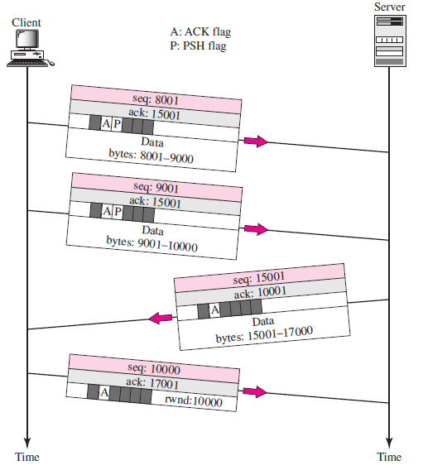
TCP Data Transfer
After connection is established, bidirectional data transfer can take place. The client and server can both send data and acknowledgment

Slide 39
TCP Data Transfer: PSH
The data segments sent by the client have the PSH (push) flag set so that the server TCP knows to deliver data to the server process as soon as they are received.
The application program at the sending site can request a push operation. This means that the sending TCP must not wait for the window to be filled.
It must create a segment and send it immediately. The sending TCP must also set the push bit (PSH) to let the receiving TCP know that the segment includes data that must be delivered to the receiving application program as soon as possible and not to wait for more data to come.

Slide 40
TCP Data Transfer: URG
The URG bit is set when the sending application program tells the sending TCP that the piece of data is urgent.
The sending TCP creates a segment and inserts the urgent data at the beginning of the segment.
The rest of the segment can contain normal data from the buffer.
The urgent pointer field in the header defines the end of the urgent data and the start of normal data.
When the receiving TCP receives a segment with the URG bit set, it extracts the urgent data from the segment, using the value of the urgent pointer, and delivers them, out of order, to the receiving application program.

Slide 41
TCP Connection Termination
Any of the two parties involved in exchanging data (client or server) can close the connection, although it is usually initiated by the client.
Three-Way Handshaking
In a normal situation, the client TCP, after receiving a close command from the client process, sends the first segment, a FIN segment in which the FIN flag is set.

Slide 42
TCP Connection Termination
Any of the two parties involved in exchanging data (client or server) can close the connection, although it is usually initiated by the client.
Three-Way Handshaking
In a normal situation, the client TCP, after receiving a close command from the client process, sends the first segment, a FIN segment in which the FIN flag is set.
The server TCP, after receiving the FIN segment, informs its process of the situation and sends the second segment, a FIN + ACK segment, to confirm the receipt of the FIN segment from the client and at the same time to announce the closing of the connection in the other direction.
The client TCP sends the last segment, an ACK segment, to confirm the receipt of the FIN segment from the TCP server. This segment contains the acknowledgment number, which is 1 plus the sequence number received in the FIN segment from the server. This segment cannot carry data and consumes no sequence numbers.

Slide 43
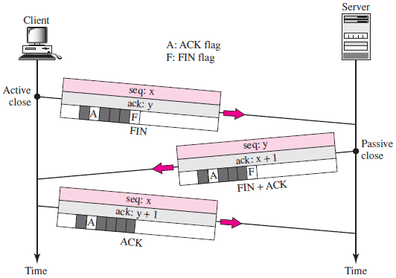
TCP Connection Termination

Slide 44
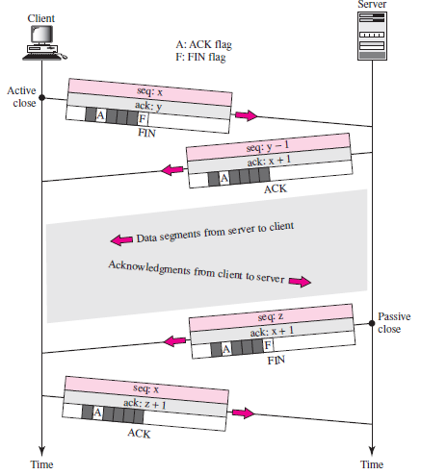
TCP Connection Termination: Half-Close

Slide 45
Flow Control in TCP
The sliding window protocol used by TCP, however, is something between the Go-Back-N and Selective Repeat sliding window.
There are two big differences between this sliding window and the one we used at the data link layer.
First, the sliding window of TCP is byte-oriented; the one we discussed in the data link layer is frame-oriented.
Second, the TCP’s sliding window is of variable size; the one we discussed in the data link layer was of fixed size
The window is opened, closed, or shrunk.
Opening a window means moving the right wall to the right. This allows more new bytes in the buffer that are eligible for sending.
Closing the window means moving the left wall to the right. This means that some bytes have been acknowledged

Slide 46
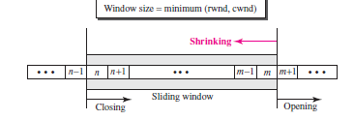
Flow Control in TCP
Shrinking the window means moving the right wall to the left. This is strongly discouraged and not allowed in some implementations because it means revoking the eligibility of some bytes for sending
A sliding window is used to make transmission more efficient as well as to control the flow of data so that the destination does not become overwhelmed with data. TCP sliding windows are byte-oriented.

Slide 47
The size of the window at one end is determined by the lesser of two values: receiver window (rwnd) or congestion window (cwnd).
The receiver window is the value advertised by the opposite end in a segment containing acknowledgment.
It is the number of bytes the other end can accept before its buffer overflows and data are discarded.
The congestion window is a value determined by the network to avoid congestion

Slide 48
SCTP (Stream Control Transmission Protocol)
Stream Control Transmission Protocol (SCTP) is a new reliable, message-oriented transport layer protocol.
SCTP, however, is mostly designed for Internet applications that have recently been introduced.
These new applications, such as IUA (ISDN over IP), M2UA and M3UA (telephony signalling), H.248 (media gateway control), H.323 (IP telephony), and SIP (IP telephony), need a more sophisticated service than TCP can provide.
SCTP combines the best features of UDP and TCP. SCTP is a reliable message oriented protocol.
It preserves the message boundaries and at the same time detects lost data, duplicate data, and out-of-order data. It also has congestion control and flow control mechanisms.

Slide 49
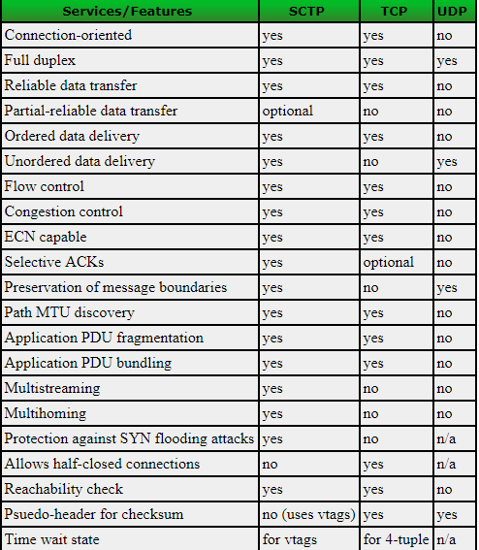

Slide 50
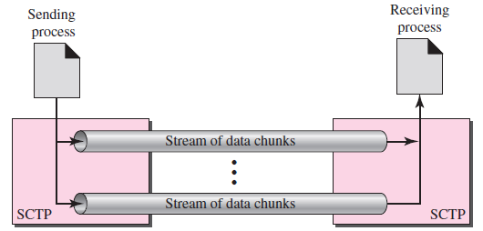
SCTP Services
Process-to-Process Communication
Multiple Streams
SCTP allows multistream service in each connection, which is called association in SCTP terminology. If one of the streams is blocked, the other streams can still deliver their data. The idea is similar to multiple lanes on a highway. Each lane can be used for a different type of traffic. For example, one lane can be used for regular traffic, another for car pools. If the traffic is blocked for regular vehicles, car pool vehicles can still reach their destinations.

Slide 51
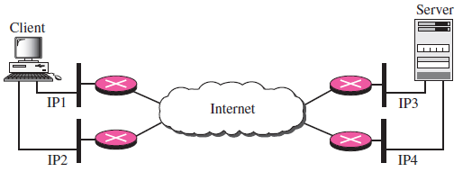
SCTP Services
Multihoming: An SCTP association, on the other hand, supports multihoming service. The sending and receiving host can define multiple IP addresses in each end for an association. In this fault-tolerant approach, when one path fails, another interface can be used for data delivery without interruption. This fault-tolerant feature is very helpful when we are sending and receiving a real-time payload such as Internet telephony.

Slide 52
SCTP Services
Full-Duplex Communication
Connection-Oriented Service
Reliable Service

Slide 53
SCTP Features
Transmission Sequence Number: The unit of data in SCTP is a DATA chunk which may or may not have a one-to-one relationship with the message coming from the process because of fragmentation. Data transfer in SCTP is controlled by numbering the data chunks. SCTP uses a transmission sequence number (TSN) to number the data chunks. In other words, the TSN in SCTP plays the analogous role to the sequence number in TCP. TSNs are 32 bits long and randomly initialized between 0 and 2³² − 1. Each data chunk must carry the corresponding TSN in its header.
Stream Identifier: In TCP, there is only one stream in each connection. In SCTP, there may be several streams in each association. Each stream in SCTP needs to be identified by using a stream identifier (SI). Each data chunk must carry the SI in its header so that when it arrives at the destination, it can be properly placed in its stream. The SI is a 16-bit number starting from 0.

Slide 54
SCTP Features
Stream Sequence Number: When a data chunk arrives at the destination SCTP, it is delivered to the appropriate stream and in the proper order. This means that, in addition to an SI, SCTP defines each data chunk in each stream with a stream sequence number (SSN).
Packets In SCTP data carried as data chunks, control information is carried as control chunks. Several control chunks and data chunks can be packed together in a packet. A packet in SCTP plays the same role as a segment in TCP.
The difference between an SCTP packet and a TCP segment:
The control information in TCP is part of the header; the control information in SCTP is included in the control chunks. There are several types of control chunks; each is used for a different purpose.
The data in a TCP segment treated as one entity; an SCTP packet can carry several data chunks; each can belong to a different stream.

Slide 55
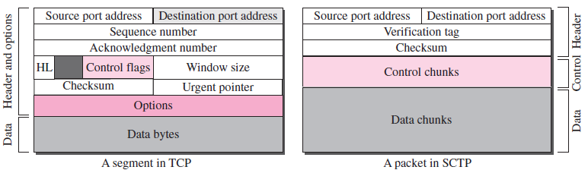
SCTP Features

Slide 56
SCTP Features
The options section, which can be part of a TCP segment, does not exist in an SCTP packet. Options in SCTP are handled by defining new chunk types.
The mandatory part of the TCP header is 20 bytes, while the general header in SCTP is only 12 bytes. The SCTP header is shorter due to the following:
a. An SCTP sequence number (TSN) belongs to each data chunk and hence is located in the chunk’s header.
b. The acknowledgment number and window size are part of each control chunk.
c. There is no need for a header length field (shown as HL in the TCP segment) because there are no options to make the length of the header variable; the SCTP header length is fixed (12 bytes).
d. There is no need for an urgent pointer in SCTP.

Slide 57
SCTP Features
5. The checksum in TCP is 16 bits; in SCTP, it is 32 bits.
6. The verification tag in SCTP is an association identifier, which does not exist in TCP. In TCP, the combination of IP and port addresses defines a connection; in SCTP we may have multihoming using different IP addresses. A unique verification tag is needed to define each association.
7. TCP includes one sequence number in the header, which defines the number of the first byte in the data section. An SCTP packet can include several different data chunks. TSNs, SIs, and SSNs define each data chunk.
8. Some segments in TCP that carry control information (such as SYN and FIN) need to consume one sequence number; control chunks in SCTP never use a TSN, SI, or SSN. These three identifiers belong only to data chunks, not to the whole packet.

Slide 58
SCTP Features
Example: In SCTP, we have data chunks, streams, and packets. An association may send many packets, a packet may contain several chunks, and chunks may belong to different streams. To make the definitions of these terms clear, let us suppose that process A needs to send 11 messages to process B in three streams. The first four messages are in the first stream, the second three messages are in the second stream, and the last four messages are in the third stream.
The application process delivers 11 messages to SCTP, where each message is earmarked for the appropriate stream. Although the process could deliver one message from the first stream and then another from the second, we assume that it delivers all messages belonging to the first stream first, all messages belonging to the second stream next, and finally, all messages belonging to the last stream.

Slide 59
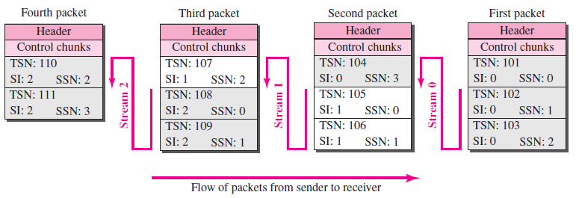
SCTP Features
It is assumed that the network allows only three data chunks per packet, which means that we need four packets as shown in Figure. Data chunks in stream 0 are carried in the first packet and part of the second packet; those in stream 1 are carried in the second and third packets; those in stream 2 are carried in the third and fourth packets.

Slide 60
SCTP Features
Acknowledgment Number: SCTP acknowledgment numbers are chunk-oriented. They refer to the TSN. A second difference between TCP and SCTP acknowledgments is the control information. In SCTP, however, the control information is carried by control chunks, which do not need a TSN. These control chunks are acknowledged by another control chunk of the appropriate type (some need no acknowledgment). For example, an INIT control chunk is acknowledged by an INIT ACK chunk. There is no need for a sequence number or an acknowledgment number.
Flow Control
Error Control: Like TCP, SCTP implements error control to provide reliability. TSN numbers and acknowledgment numbers are used for error control.
Congestion Control: Like TCP, SCTP implements congestion control to determine how many data chunks can be injected into the network.

Slide 61
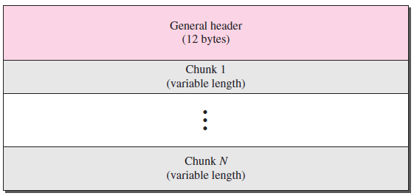
SCTP Packet Format
An SCTP packet has a mandatory general header and a set of blocks called chunks. There are two types of chunks: control chunks and data chunks. A control chunk controls and maintains the association; a data chunk carries user data. In a packet, the control chunks come before the data chunks.

Slide 62
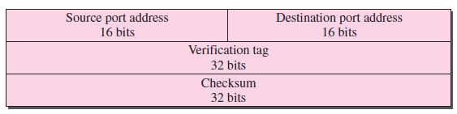
SCTP Packet Format
General Header: The general header (packet header) defines the endpoints of each association to which the packet belongs, guarantees that the packet belongs to a particular association, and preserves the integrity of the contents of the packet including the header itself.

Slide 63
SCTP Packet Format
Source port address. This is a 16-bit field that defines the port number of the process sending the packet.
Destination port address. This is a 16-bit field that defines the port number of the process receiving the packet.
Verification tag. This is a number that matches a packet to an association. This prevents a packet from a previous association from being mistaken as a packet in this association. It serves as an identifier for the association; it is repeated in every packet during the association. There is a separate verification used for each direction in the association.
Checksum. This 32-bit field contains a CRC-32 checksum. Note that the size of the checksum is increased from 16 (in UDP, TCP, and IP) to 32 bits to allow the use of the CRC-32 checksum.

Slide 64
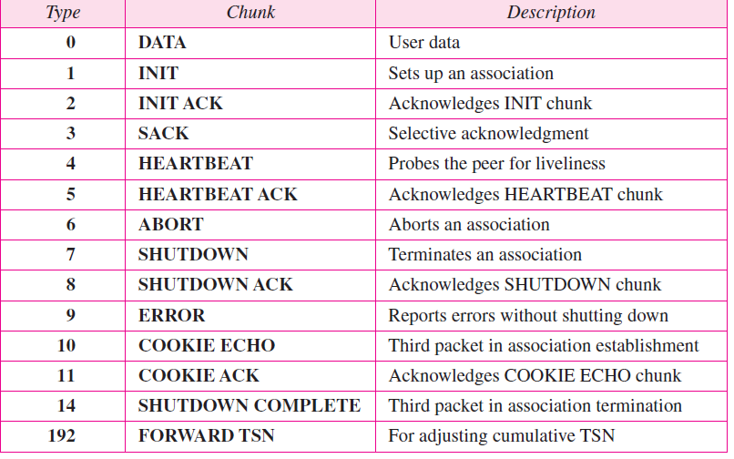
SCTP Packet Format
Chunks: Control information or user data are carried in chunks. The first three fields are common to all chunks; the information field depends on the type of chunk. The important point to remember is that SCTP requires the information section to be a multiple of 4 bytes; if not, padding bytes (eight 0s) are added at the end of the section.

Slide 65
An SCTP Association
A connection in SCTP is called an association to emphasize multihoming.
Association establishment in SCTP requires a four-way handshake. In this procedure, a process, normally a client, wants to establish an association with another process, normally a server, using SCTP as the transport layer protocol. Similar to TCP, the SCTP server needs to be prepared to receive any association (passive open). Association establishment, however, is initiated by the client (active open). The steps, in a normal situation, are as follows:
1. The client sends the first packet, which contains an INIT chunk.
2. The server sends the second packet, which contains an INIT ACK chunk.
3. The client sends the third packet, which includes a COOKIE ECHO chunk. This is a very simple chunk that echoes, without change, the cookie sent by the server. SCTP allows the inclusion of data chunks in this packet.
4. The server sends the fourth packet, which includes the COOKIE ACK chunk that acknowledges the receipt of the COOKIE ECHO chunk. SCTP allows the inclusion of data chunks with this packet.

Slide 66
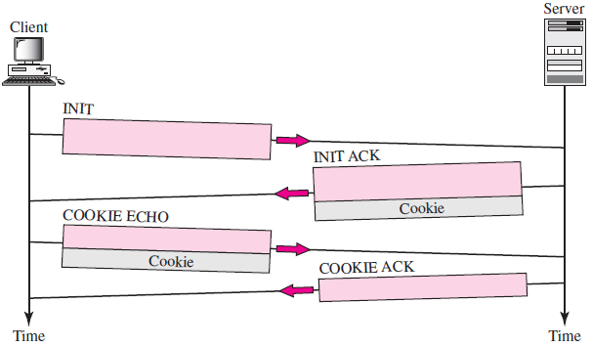
An SCTP Association

Slide 67
An SCTP Association
The designers of SCTP have a strategy to prevent SYN flooding attack(Cookie). The strategy is to postpone the allocation of resources until the reception of the third packet, when the IP address of the sender is verified. The information received in the first packet must somehow be saved until the third packet arrives. But if the server saved the information, that would require the allocation of resources (memory); this is the dilemma. The solution is to pack the information and send it back to the client. This is called generating a cookie. The cookie is sent with the second packet to the address received in the first packet. There are two potential situations:
If the sender of the first packet is an attacker, the server never receives the third packet; the cookie is lost and no resources are allocated. The only effort for the server is creating the cookie.

Slide 68
An SCTP Association
2. If the sender of the first packet is an honest client that needs to make a connection, it receives the second packet, with the cookie. It sends a packet (third in the series) with the cookie, with no changes. The server receives the third packet and knows that it has come from an honest client because the cookie that the sender has sent is there. The server can now allocate resources.

Slide 69
SCTP Data Transfer
The whole purpose of an association is to transfer data between two ends. After the association is established, bidirectional data transfer can take place. The client and the server can both send data. Like TCP, SCTP supports piggybacking.
SCTP, on the other hand, recognizes and maintains boundaries. Each message coming from the process is treated as one unit and inserted into a DATA chunk unless it is fragmented.
Each DATA chunk formed by a message or a fragment of a message has one TSN. Only DATA chunks use TSNs and only DATA chunks are acknowledged by SACK chunks.

Slide 70
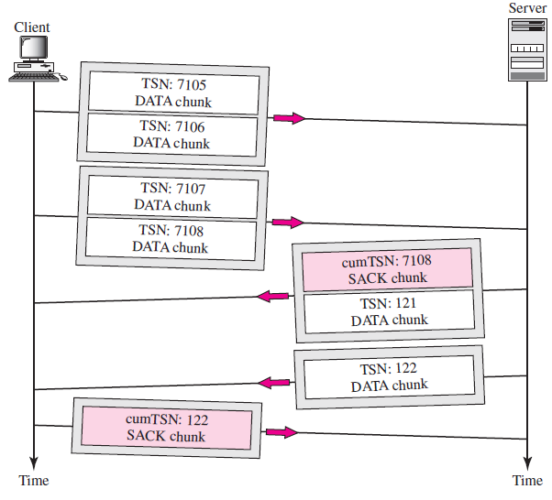
SCTP Data Transfer

Slide 71
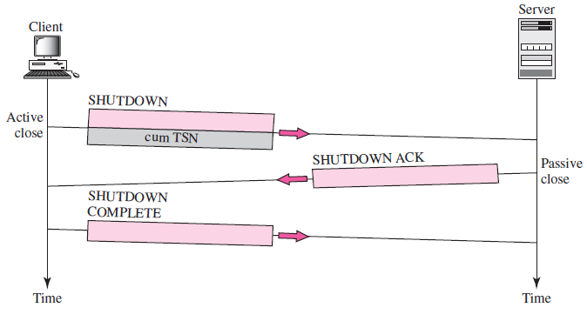
SCTP (Association Termination)
In SCTP, either of the two parties involved in exchanging data (client or server) can close the connection. However, unlike TCP, SCTP does not allow a halfclose situation. If one end closes the association, the other end must stop sending new data. If any data are left over in the queue of the recipient of the termination request, they are sent and the association is closed.

Slide 72
Congestion
Congestion in a network may occur if the load on the network—the number of packets sent to the network—is greater than the capacity of the network—the number of packets a network can handle.
Congestion control refers to the mechanisms and techniques to control the congestion and keep the load below the capacity.
Congestion happens in any system that involves waiting. For example, congestion happens on a freeway because any abnormality in the flow, such as an accident during rush hour, creates blockage.
Congestion in a network or internet work occurs because routers and switches have queues—buffers that hold the packets before and after processing.
A router, for example, has an input queue and an output queue for each interface.
When a packet arrives at the incoming interface, it undergoes three steps before departing

Slide 73
Congestion
When a packet arrives at the incoming interface, it undergoes three steps before departing:
1. The packet is put at the end of the input queue while waiting to be checked.
2. The processing module of the router removes the packet from the input queue once it reaches the front of the queue and uses its routing table and the destination address to find the route.
3. The packet is put in the appropriate output queue and waits its turn to be sent.
First, if the rate of packet arrival is higher than the packet processing rate, the input queues become longer and longer.
Second, if the packet departure rate is less than the packet processing rate, the output queues become longer and longer.

Slide 74
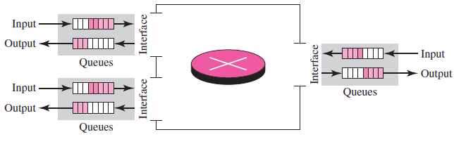
Congestion

Slide 75
Congestion: Network Performance
Congestion control involves two factors that measure the performance of a network: delay and throughput.
Delay Versus Load
When the load is much less than the capacity of the network, the delay is at a minimum.
This minimum delay is composed of propagation delay and processing delay, both of which are negligible.

Slide 76
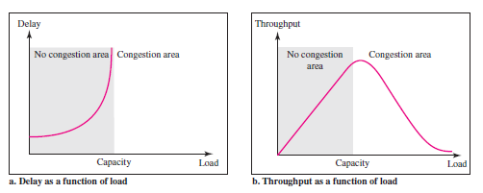
However, when the load reaches the network capacity, the delay increases sharply because we now need to add the waiting time in the queues (for all routers in the path) to the total delay

Slide 77
Throughput Versus Load
We can define throughput in a network as the number of packets passing through the network in a unit of time.
Notice that when the load is below the capacity of the network, the throughput increases proportionally with the load.
We expect the throughput to remain constant after the load reaches the capacity, but instead the throughput declines sharply.
The reason is the discarding of packets by the routers. When the load exceeds the capacity, the queues become full and the routers have to discard some packets.
Discarding packets does not reduce the number of packets in the network because the sources retransmit the packets, using time-out mechanisms, when the packets do not reach the destinations.

Slide 78
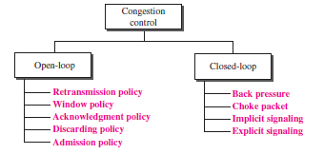
Congestion Control
Congestion control refers to techniques and mechanisms that can either prevent congestion, before it happens, or remove congestion, after it has happened.
In general, we can divide congestion control mechanisms into two broad categories: open-loop congestion control (prevention) and closed-loop congestion control (removal)

Slide 79
Congestion Control
Open-Loop Congestion Control
In open-loop congestion control, policies are applied to prevent congestion before it happens.
Retransmission Policy
Retransmission is sometimes unavoidable. If the sender feels that a sent packet is lost or corrupted, the packet needs to be retransmitted.
Retransmission in general may increase congestion in the network.
However, a good retransmission policy can prevent congestion. The retransmission policy and the retransmission timers must be designed to optimize efficiency and at the same time prevent congestion.
For example, the retransmission policy used by TCP (explained later) is designed to prevent or alleviate congestion.

Slide 80
Congestion Control
Window Policy
The type of window at the sender may also affect congestion. The Selective Repeat window is better than the Go-Back-N window for congestion control
Acknowledgment Policy
The acknowledgment policy imposed by the receiver may also affect congestion.
If the receiver does not acknowledge every packet it receives, it may slow down the sender and help prevent congestion
Discarding Policy
A good discarding policy by the routers may prevent congestion and at the same time may not harm the integrity of the transmission.

Slide 81
Congestion Control
For example, in audio transmission, if the policy is to discard less sensitive packets when congestion is likely to happen, the quality of sound is still preserved and congestion is prevented or alleviated.
Admission Policy
An admission policy, which is a quality-of-service mechanism, can also prevent congestion in virtual-circuit networks.
Switches in a flow first check the resource requirement of a flow before admitting it to the network.
A router can deny establishing a virtual circuit connection if there is congestion in the network or if there is a possibility of future congestion.

Slide 82
Congestion Control Closed-Loop Congestion Control
Closed-loop congestion control mechanisms try to alleviate congestion after it happens. Several mechanisms have been used by different protocols
Backpressure
The technique of backpressure refers to a congestion control mechanism in which a congested node stops receiving data from the immediate upstream node or nodes.
This may cause the upstream node or nodes to become congested, and they, in turn, reject data from their upstream nodes or nodes. And so on.
Backpressure is a node-to-node congestion control that starts with a node and propagates, in the opposite direction of data flow, to the source.

Slide 83

Congestion Control Closed-Loop Congestion Control
The backpressure technique can be applied only to virtual circuit networks, in which each node knows the upstream node from which a flow of data is coming. Figure shows the idea of backpressure.
Choke Packet
A choke packet is a packet sent by a node to the source to inform it of congestion.
Note the difference between the backpressure and choke packet methods.

Slide 84
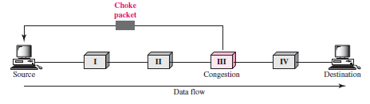
In backpressure, the warning is from one node to its upstream node, although the warning may eventually reach the source station.
In the choke packet method, the warning is from the router, which has encountered congestion, to the source station directly.
The intermediate nodes through which the packet has travelled are not warned.

Slide 85
Implicit Signalling
In implicit signalling, there is no communication between the congested node or nodes and the source
The source guesses that there is a congestion somewhere in the network from other symptoms. For example, when a source sends several packets and there is no acknowledgment for a while, one assumption is that the network is congested
Explicit Signalling
The node that experiences congestion can explicitly send a signal to the source or destination.
The explicit signalling method, however, is different from the choke packet method.
In the choke packet method, a separate packet is used for this purpose; in the explicit signalling method, the signal is included in the packets that carry data.

Slide 86
Backward Signalling
A bit can be set in a packet moving in the direction opposite to the congestion.
This bit can warn the source that there is congestion and that it needs to slow down to avoid the discarding of packets.
Forward Signalling
A bit can be set in a packet moving in the direction of the congestion. This bit can warn the destination that there is congestion.
The receiver in this case can use policies, such as slowing down the acknowledgments, to alleviate the congestion.

Slide 87
Congestion Control in TCP: Congestion Window
The sender window size is determined by the available buffer space in the receiver (rwnd).
It is assumed that it is only the receiver that can dictate to the sender the size of the sender’s window.
If the network cannot deliver the data as fast as they are created by the sender, it must tell the sender to slow down.
Today, the sender’s window size is determined not only by the receiver but also by congestion in the network.
The sender has two pieces of information: the receiver-advertised window size and the congestion window size.
The actual size of the window is the minimum of these two. Receiver window and congestion window.

Slide 88
Congestion Control in TCP: Congestion Policy
Congestion handling is based on three phases:
Slow Start
Congestion Avoidance
Congestion Detection
In the slow-start phase, the sender starts with a very slow rate of transmission, but increases the rate rapidly to reach a threshold.
When the threshold is reached, the data rate is reduced to avoid congestion.
Finally if congestion is detected, the sender goes back to the slow start or congestion avoidance phase based on how the congestion is detected.

Slide 89
Congestion Control in TCP: Slow Start: Exponential Increase
The size of the congestion window (cwnd) starts with one maximum segment size (MSS).
The MSS is determined during connection establishment by using an option of the same name.
The size of the window increases one MSS each time an acknowledgment is received.
As the name implies, the window starts slowly, but grows exponentially.
It is assumed in example that receiver window (rwnd) is much higher than congestion window (cwnd) and each segment is acknowledged individually.
The sender starts with cwnd = 1 MSS. This means that the sender can send only one segment. After receipt of the acknowledgment for segment 1, the size of the congestion window is increased by 1, which means that cwnd is now 2. Now two more segments can be sent. When each acknowledgment is received, the size of the window is increased by 1 MSS. When all seven segments are acknowledged, cwnd = 8.

Slide 90
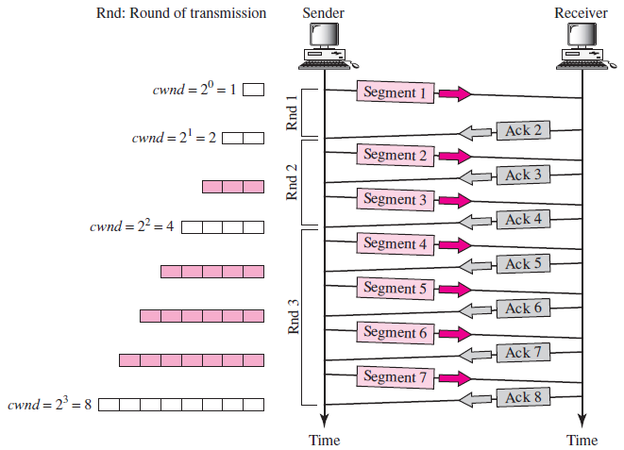
Congestion Control in TCP: Slow Start: Exponential Increase

Slide 91
Congestion Control in TCP: Slow Start: Exponential Increase
Slow start cannot continue indefinitely. There must be a threshold to stop this phase.
The sender keeps track of a variable named ssthresh (slow-start threshold).
When the size of window in bytes reaches this threshold, slow start stops and the next phase starts.
In most implementations the value of ssthresh is 65,535 bytes.

Slide 92
Congestion Control in TCP: Congestion Avoidance: Additive Increase
When the size of the congestion window reaches the slow-start threshold, the slow-start phase stops and the additive phase begins.
In this algorithm, each time the whole window of segments is acknowledged (one round), the size of the congestion window is increased by 1.
To show the idea, we apply this algorithm to the same scenario as slow start, although we will see that the congestion avoidance algorithm usually starts when the size of the window is much greater than 1.
In this case, after the sender has received acknowledgments for a complete window size of segments, the size of the window is increased by one segment.

Slide 93
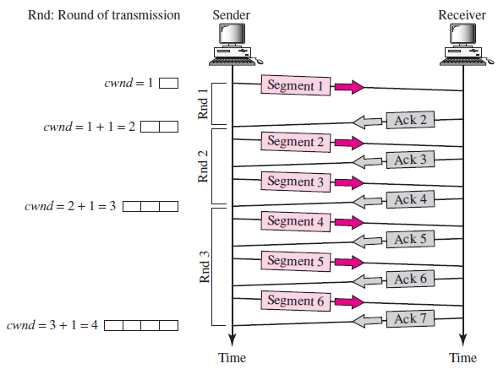
Congestion Control in TCP: Congestion Avoidance: Additive Increase

Slide 94
Congestion Control in TCP:Congestion Detection: Multiplicative Decrease
If congestion occurs, the congestion window size must be decreased.
The only way the sender can guess that congestion has occurred is by the need to retransmit a segment. However, retransmission can occur in one of two cases: when a timer times out or when three ACKs are received. In both cases, the size of the threshold is dropped to one-half, a multiplicative decrease.

Slide 95
Congestion Control in TCP:Congestion Detection: Multiplicative Decrease
Most TCP implementations have two reactions:
If a time-out occurs, there is a stronger possibility of congestion; a segment has probably been dropped in the network, and there is no news about the sent segments. In this case TCP reacts strongly:
a. It sets the value of the threshold to one-half of the current window size.
b. It sets cwnd to the size of one segment.
c. It starts the slow-start phase again.
2. If three ACKs are received, there is a weaker possibility of congestion; a segment may have been dropped, but some segments after that may have arrived safely since three ACKs are received. This is called fast transmission and fast recovery. In this case, TCP has a weaker reaction:
a. It sets the value of the threshold to one-half of the current window size.
b. It sets cwnd to the value of the threshold (some implementations add three segment sizes to the threshold).
c. It starts the congestion avoidance phase.

Slide 96
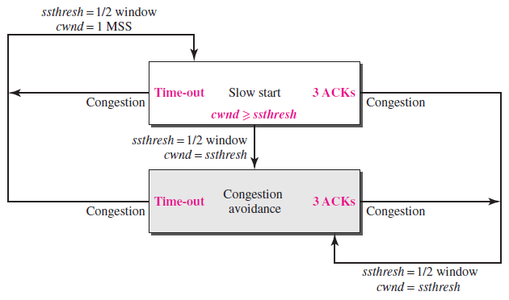
TCP Congestion Policy Summary

Slide 97
Congestion Control in TCP
In Example, it is assumed that the maximum window size is 32 segments.
The threshold is set to 16 segments (one-half of the maximum window size).
In the slow-start phase the window size starts from 1 and grows exponentially until it reaches the threshold.
After it reaches the threshold, the congestion avoidance (additive increase) procedure allows the window size to increase linearly until a timeout occurs or the maximum window size is reached.
In Figure, the time-out occurs when the window size is 20. At this moment, the multiplicative decrease procedure takes over and reduces the threshold to one-half of the previous window size.
The previous window size was 20 when the time-out happened so the new threshold is now 10.

Slide 98
Congestion Control in TCP
TCP moves to slow start again and starts with a window size of 1, and TCP moves to additive increase when the new threshold is reached.
When the window size is 12, a three-ACKs event happens. The multiplicative decrease procedure takes over again.
The threshold is set to 6 and TCP goes to the additive increase phase this time.
It remains in this phase until another time-out or another three ACKs happen.

Slide 99
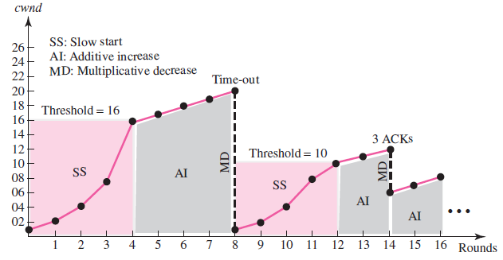
Congestion Control in TCP

